Slide 1


.NET Track
Employee Travel Booking Project
Presented by Vidya Mane- 220359

Slide 2

/02
Contents
This presentation outlines the Employee Travel Booking Project for the .NET Track, including project objective, introduction, architecture, Project screen, Conclusion.

Slide 3

/03
Problem Statement
The project aims to address the need for an Employee Travel Booking system in the corporate world, streamlining the travel request processes.

Slide 4
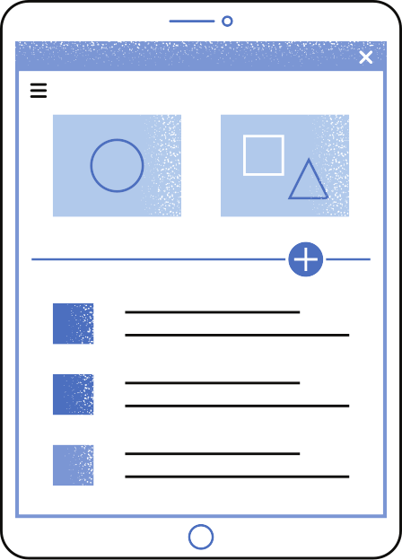

/04
Objective
To develop an Employee Travel Booking Application that enables employees to request travel tickets and managers and to approve business travel requests efficiently.

Slide 5

/05
Abstract
The Employee Travel Booking MVC Project redefines corporate travel management. This MVC-based application streamlines travel requests, integrating seamlessly with a robust database for secure data handling. With an intuitive web interface, employees submit requests, undergo manager approvals, and upon confirmation, travel agents finalize bookings. The MVC architecture ensures efficiency, centralization, and optimal communication throughout the travel management process. Simplifying complexities, this project is a dynamic solution for modern corporate travel needs.

Slide 6

/06
Introduction
In today's fast-paced corporate world, where travel is a common necessity, our Employee Travel Booking MVC Application offers a unified solution for employees, managers, and travel agents. This versatile tool simplifies travel requests, enhances data security, Join us in exploring this all-in-one travel management solution that caters to the diverse needs of your organization.

Slide 7
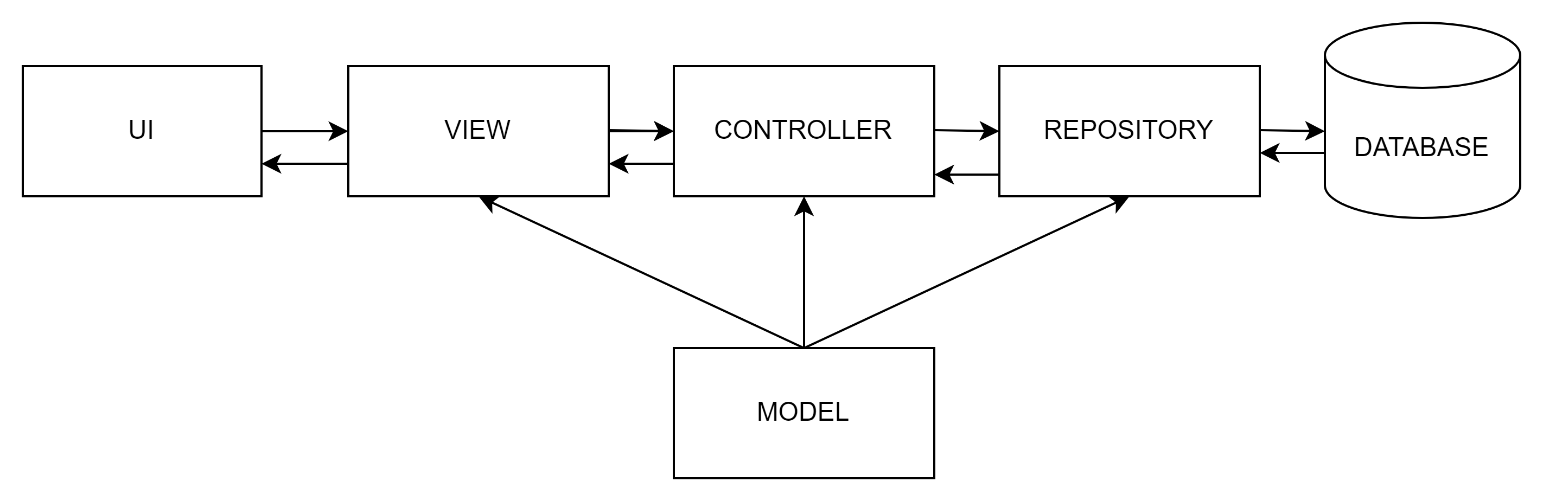
/07
Architecture

Slide 8
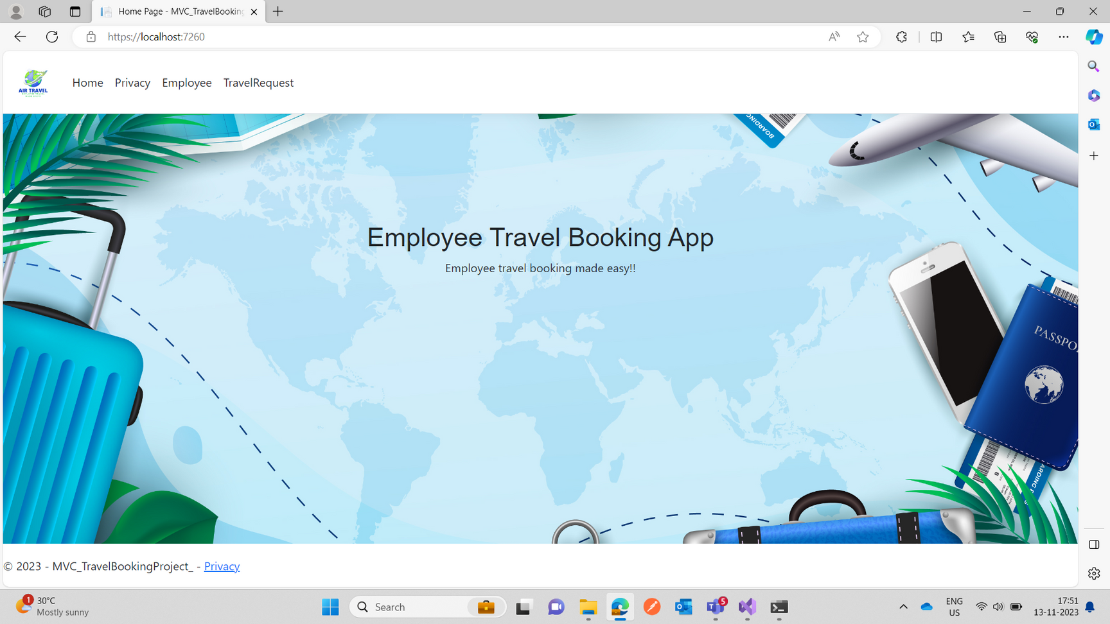
Project Screen
/8

Slide 9
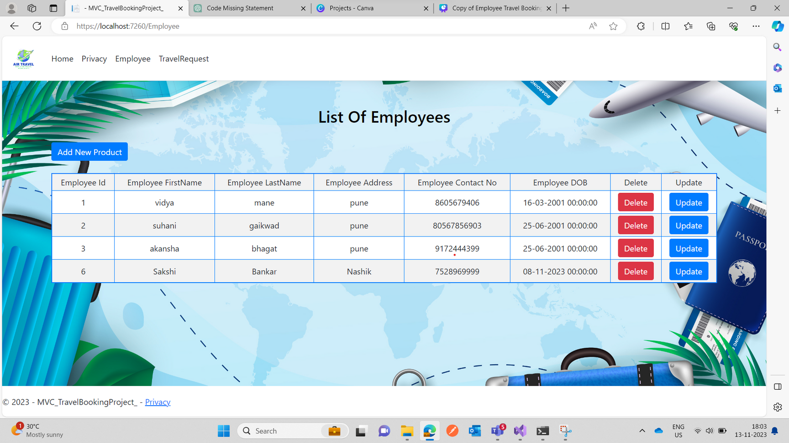
Project Screen
/9

Slide 10
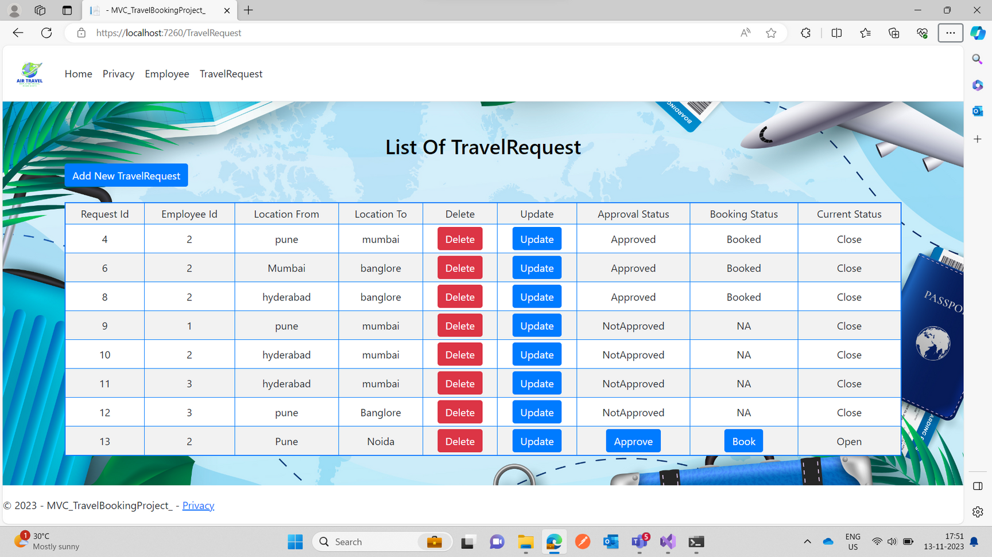
Project Screen
/10

Slide 11

/11
Conclusion
In closing, the Employee Travel Booking MVC Application is your one-stop solution for efficient travel management. It simplifies the travel request process, enhances security, and supports decision-making. With a user-friendly interface, it caters to employees, managers, and travel agents, making it the perfect tool for modern businesses.

Slide 12


/12
Thank You!!

